Slide 1
CSS Specificity
Mike shoaf
Cit 230

Slide 2
Specificity
Specificity is the means by which browsers decide which CSS property values are the most relevant to an element and, therefore, will be applied.
There are 4 types of specificity
Inline
IDs
Classes
Types

Slide 3
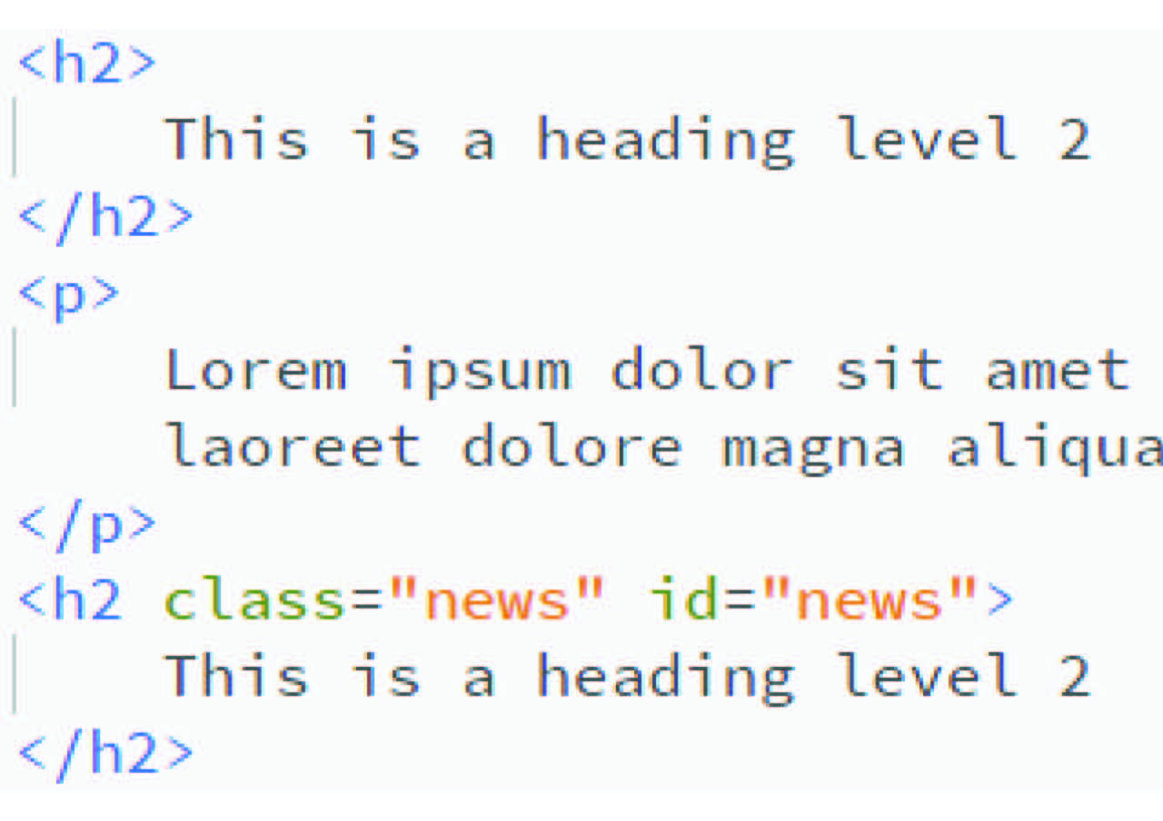
Types
Types are classified as:
Elements
i.e.:
h2, p, etc…
Code in CSS:
h2 { color: green }
This will change ALL h2 elements

Slide 4
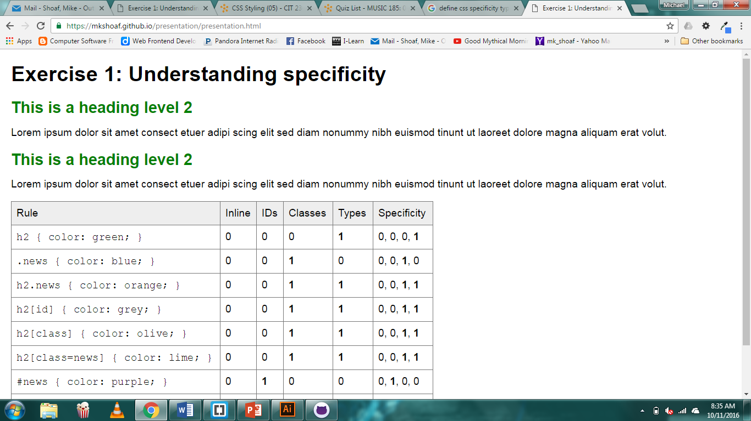
How it looks

